Slide 1
PROJECT 1
By
WAMBUI KARIUKI

Slide 2


Slide 3
Genre Insights and Content Composition Analysis on an Entertainment Platform

Slide 4
PROJECT OVERVIEW
In this project, I aim to provide valuable insights to Microsoft as they embark on establishing a new movie studio. Leveraging on exploratory data analysis techniques, we will delve into various movie datasets to understand current trends in the box office. By examining factors such as movie genres, ratings, and box office performance, we will generate actionable recommendations to guide Microsoft in making informed decisions regarding their movie production strategy

Slide 5
BUSINESS UNDERSTANDING
Microsoft recognizes the growing importance of original video content in the entertainment industry and seeks to capitalize on this trend by venturing into movie production. However, lacking prior experience in the film industry, Microsoft aims to gain insights into the types of films that resonate well with audiences and perform strongly at the box office. By understanding market trends and audience preferences, Microsoft can strategically position themselves to maximize the success of their movie ventures.

Slide 6
PROBLEM STATEMENT
Microsoft is entering the movie production industry without prior expertise and seeks guidance on the types of films that are currently successful at the box office. The challenge lies in analyzing extensive movie data to identify key trends and translate these findings into actionable insights that will inform Microsoft's movie production strategy.

Slide 7
OBJECTIVES
1. Evaluate the Relationship Between IMDb Ratings and Audience Engagement.
2. Identify High-Performing Titles Across Different Categories
3. Analyze Category Contributions to Overall Ratings and Engagement
4. Detect Patterns or Trends in Audience Preferences

Slide 8
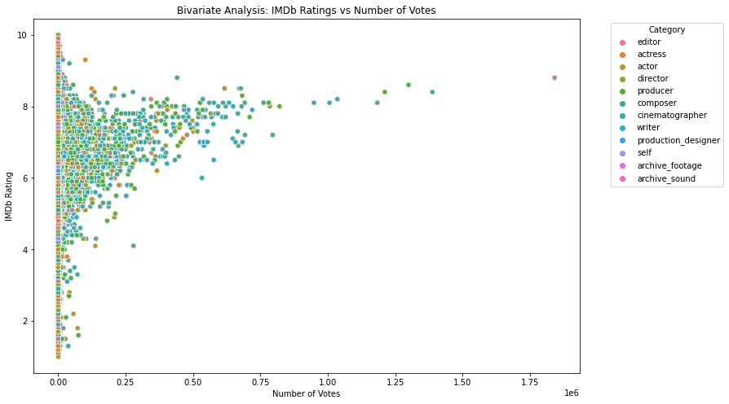
OBJECTIVE 1 :Evaluate the Relationship Between IMDb Ratings and Audience Engagement

Slide 9
CONTINUATION
The scatter plot, designed to assess the correlation between IMDb ratings and audience engagement, revealed several interesting insights. The graph displayed IMDb ratings on the y-axis, representing the average rating given by viewers, and the number of votes on the x-axis, indicating the level of audience engagement or popularity for each title. Each data point was color-coded based on the category of individuals involved in the production, providing an additional layer of information.
Insights:
Positive Correlation Confirmed between IMDb ratings and the number of votes. Titles with higher ratings tended to attract a larger number of votes, indicating a relationship between content quality and audience engagement.
Category Influence on Ratings: Analysis of the color-coded points allowed for the identification of categories that contributed significantly to both high IMDb ratings and increased audience engagement. This insight helps understand the impact of different roles on overall content performance.

Slide 10
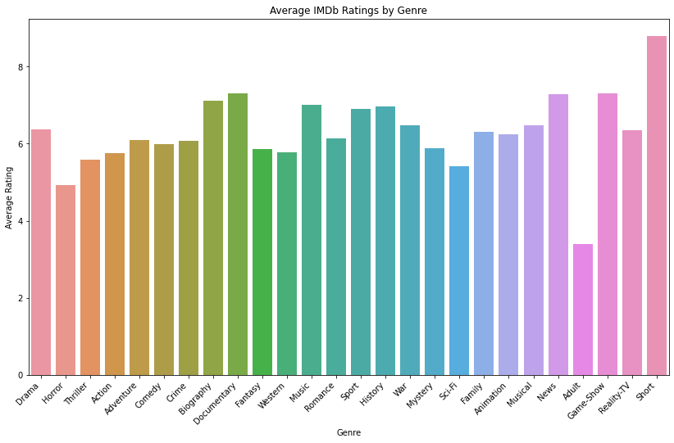
2. Identify High-Performing Titles Across Different Categories

Slide 11
2. CONTINUATION
The bar plot effectively serves the objective of identifying high-performing titles across different genres by highlighting the average IMDb ratings within each genre. These findings empower stakeholders to make informed decisions about content creation, genre-specific marketing, and audience engagement strategies

Slide 12
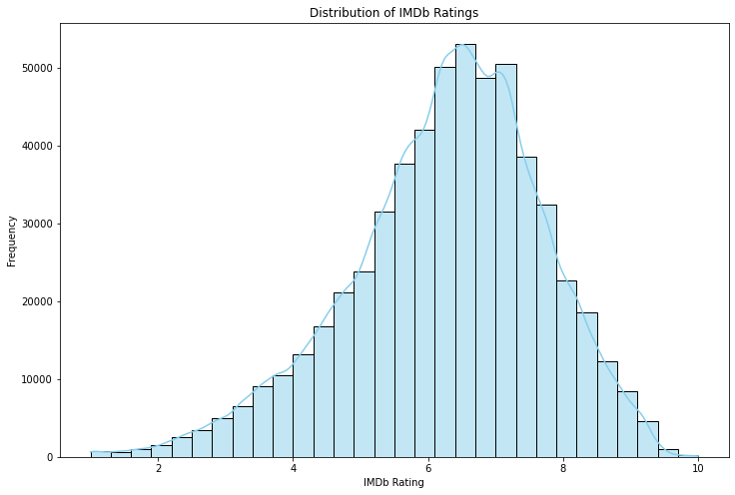
3. Analyze Category Contributions to Overall Ratings and Engagement

Slide 13
OBJECTIVE 3. CONTINUATION
The histogram above shows :
Spread of Ratings showing a wider spread of ratings suggests a diverse range of ratings, indicating varied audience reactions to the content
Skewness and Symmetry, Symmetrical distributions suggest a balanced distribution of ratings, while skewness indicates a bias towards one end
Identifying Peaks and Valleys: Peaks in the histogram represent rating values with higher frequency, suggesting popular or well-received content
The histogram effectively fulfills the objective of analyzing the distribution of IMDb ratings. The findings offer a nuanced understanding of user engagement, preferences, and the overall landscape of IMDb ratings within the dataset. These insights can guide content creators and platform administrators in optimizing their content strategy and enhancing user satisfaction.

Slide 14
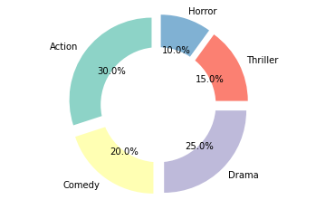
4. Detect Patterns or Trends in Audience Preferences

Slide 15
4. continuation
Genres with larger slices indicate a higher percentage occurrence, while smaller slices represent less prevalent genres
These dominant genres may have a more significant presence and influence on the overall content landscape
Understanding the distribution of genres helps in aligning content strategies with the preferences of the user base.

